Slide 1
CryptoProSoft
by StakeProSoft
AI
CryptoProSoft
AI Crypto Trading Bot 2027
Coming soon · Join the waitlist for early access
Notes:
Cover. Product: AI Crypto Trading Bot 2027 by CryptoProSoft (StakeProSoft). Status: coming soon, waitlist. Source: /workspace/crypto_page/crypto.html

Slide 2
CryptoProSoft
Algorithmic trading: rules instead of gut feeling
Example rule (illustration)
IF the market is in a range
AND RSI(14) is below 35 on a closed candle
THEN buy, sized at 2% risk
EXIT at stop loss, take profit or trailing stop
A trading bot turns a strategy into exact rules. It reads live prices, calculates indicators such as RSI, EMA or ATR, and acts only when every condition is met. AI adds a second layer: it reads the news, reviews results and suggests better settings.
The same rule runs the same way, every time.
Notes:
How algorithmic trading works: a strategy becomes exact rules that a program checks on live data. The rule on the right is an illustration, not a recommendation. RSI buy level 35 = bot default (facts.md, strategy-config). Sources: /workspace/crypto_page/facts.md, crypto.html

Slide 3
CryptoProSoft
Why trade with a bot?
01. Watches the market 24/7
03. Exits are always applied
Crypto never sleeps. The bot checks its signals around the clock, on closed candles only.
Stop loss, take profit and trailing stops are never skipped or moved by hand.
02. Same rules every time
04. Automatic daily loss limit
No mood and no gut feeling. Each strategy follows its own rules exactly.
A kill switch stops trading at the daily loss limit. No willpower needed.
Notes:
Manual trading vs the bot, from the comparison table on the product page. Source: /workspace/crypto_page/crypto.html

Slide 4
CryptoProSoft
How the bot works in 4 steps
1
2
3
4
Connect and choose
Read the market
Signal and risk check
Manage, exit, report
Connect your exchange in demo or live mode. Pick your pairs, strategies and risk level.
Live prices stream in. The bot checks the regime, news sentiment and the higher-timeframe trend.
A strategy fires on a closed candle. The signal passes position sizing and every risk limit.
Trailing stops, break-even and profit lock manage the trade. Results land in reports.
Notes:
4 steps from the product page "How the AI crypto trading bot works in 4 steps". Source: /workspace/crypto_page/crypto.html

Slide 5
CryptoProSoft
5 exchanges, your own account
Spot trading in USDT or USDC pairs. Your funds stay on your own exchange account, and the bot trades through your API keys.
01. Supported exchanges
02. Fees and limits built in
Binance, Bybit, Bybit EU, OKX and Bitget. Each one has a demo/testnet mode and a live mode.
Per-exchange fee rates and order-size limits apply automatically. Each user has separate keys, settings, positions and reports.
Notes:
Exchanges: Binance, Bybit, Bybit EU, OKX, Bitget, each with demo/testnet and live. Spot, USDT/USDC. Per-exchange fees and order limits. Funds stay on the user's own exchange account. Sources: /workspace/crypto_screens/crypto-robot-summary.md, crypto.html

Slide 6
CryptoProSoft
01. Trending market
ADX at 25 or higher: trend strategies such as Trend Following and Supertrend can trade.
Market-regime detection
Read the market first, then trade
02. Ranging market
ADX at 20 or lower: range strategies such as Mean Reversion and Grid can trade.
The bot measures trend strength with the ADX indicator. Then it lets the strategies that suit the current market trade, and holds back the rest.
03. Extra filters
A daily 200 EMA trend filter, news and sentiment can block a signal.
Notes:
Market-regime detection: ADX(14); trend at ADX >= 25, range at ADX <= 20 (strategy-config defaults, facts.md). Regime, sentiment and news filter decide which strategies may trade (summary). Higher-timeframe filter: daily 200 EMA. Sources: /workspace/crypto_screens/crypto-robot-summary.md, /workspace/crypto_page/facts.md

Slide 7
CryptoProSoft
9 strategies, on or off per pair
Trend Following
Mean Reversion
Supertrend
EMA/MACD trends, daily 200 EMA filter
Buys oversold dips (RSI, Bollinger)
ATR-based trend signals
Switch each strategy on or off, also per trading pair. Risk levels range from DCA (lowest) to Momentum (highest).
Divergence
Grid Accumulation
Donchian Breakout
RSI/price divergence reversals
Buys in price steps within a range
Enters above the channel high
Combined mode can ask for 2 confirmations before a trade
Momentum
DCA
AI Signal
RSI + volume spike. Highest risk
Small scheduled buys to accumulate. Lowest risk
AI buy/sell with min. confidence. Experimental
Notes:
9 strategies, each on/off and per pair. Risk notes as given by the product summary (Grid low-medium, Breakout medium, Momentum highest, DCA lowest). Combined mode min. 2 confirmations: facts.md. Sources: /workspace/crypto_screens/crypto-robot-summary.md, /workspace/crypto_page/facts.md

Slide 8
CryptoProSoft
Real AI, with automatic fallback
Claude
→
OpenAI
→
Gemini
→
Groq
AI Review and auto-tune
Choose your AI provider. If it fails (no credit, quota, rate limit or a bad key), the bot switches to the next provider that has a key.
AI news analysis. Headlines from CoinDesk, Cointelegraph, Decrypt and more are scored for sentiment, with confidence and expiry limits.
A daily or weekly AI review of your results can tune the settings. Turn it on or off, or start it by hand. Per-pair auto-tune and pair suggestions too.
The AI Signal strategy and the admin Copilot are optional. Every AI signal passes the same risk checks. It cannot skip a stop loss or the kill switch.
Notes:
AI: Claude (Anthropic), OpenAI, Google Gemini or Groq; automatic fallback to the next provider with a key when the main one fails (no credit, quota, rate limit, bad key). AI news analysis (CoinDesk, Cointelegraph, Decrypt) with confidence/expiry limits and daily trade cap. AI Review daily/weekly, on/off per account, manual start. Per-pair auto-tune, pair recommendations. AI Signal strategy, admin AI Copilot. AI signals pass the same risk pipeline. Sources: /workspace/crypto_screens/crypto-robot-summary.md, /workspace/crypto_page/facts.md, crypto.html

Slide 9
CryptoProSoft
Risk controls on every trade
01. Stop loss and take profit
03. Position sizing
3% stop loss and 6% take profit by default, with per-pair risk overrides.
2% risk per trade, at most 10% of cash per trade and at most 10 open positions.
02. Trailing stop and profit lock
04. Daily-loss kill switch
An ATR trailing stop and a break-even stop follow the trade. Profit lock secures gains after +2%.
Trading stops at a 5% daily loss (default). Pause, close-all and close-position controls.
The bot trades only on closed candles. Fees and slippage are part of the math.
Notes:
Risk defaults from the current product summary (Oct 2026). Note: older code notes (facts.md) list 4% stop loss, max 5 positions, 20% cash per trade; the summary was preferred as the newer source. Source: /workspace/crypto_screens/crypto-robot-summary.md

Slide 10
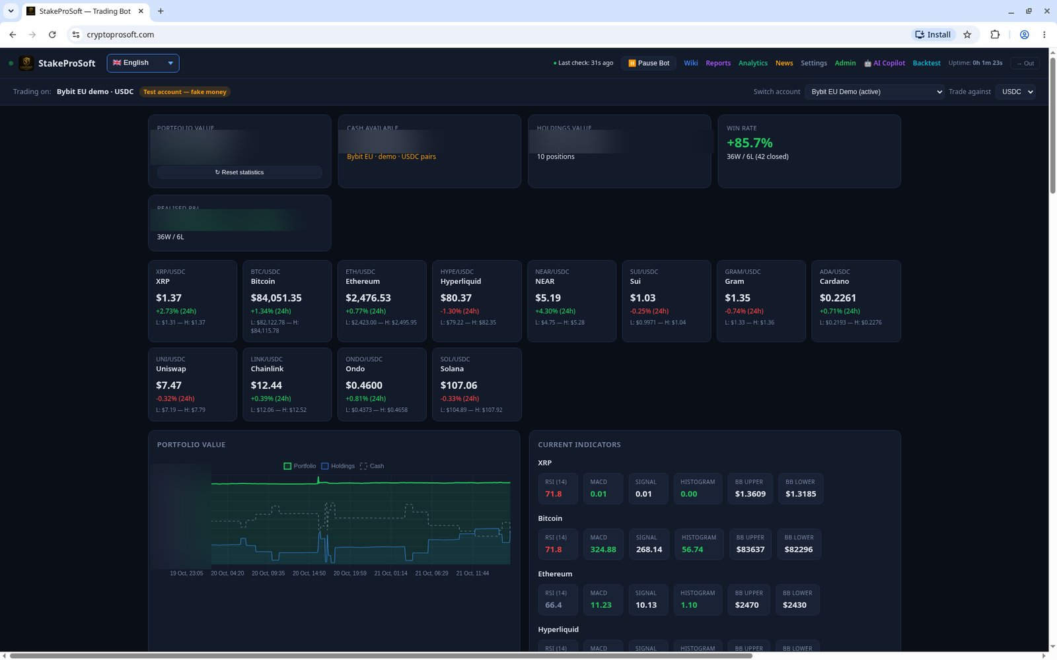
CryptoProSoft
One dashboard in your browser
Self-hosted web app · 19 languages
Strategies, positions and risk settings in one place. Install it as an app. Analytics, daily reports, a news page and a built-in manual in English and Swedish. Each user gets a separate account.
Live dashboard (demo account) – values blurred
Notes:
Screenshot: dashboard, demo account, money values blurred. Dashboard facts: self-hosted Python web app in the browser, installable as PWA, 19 languages (Google Translate drop-down), analytics, daily reports, news page, wiki/manual EN+SV, multi-user accounts. Sources: /workspace/crypto_screens/crypto-robot-summary.md

Slide 11
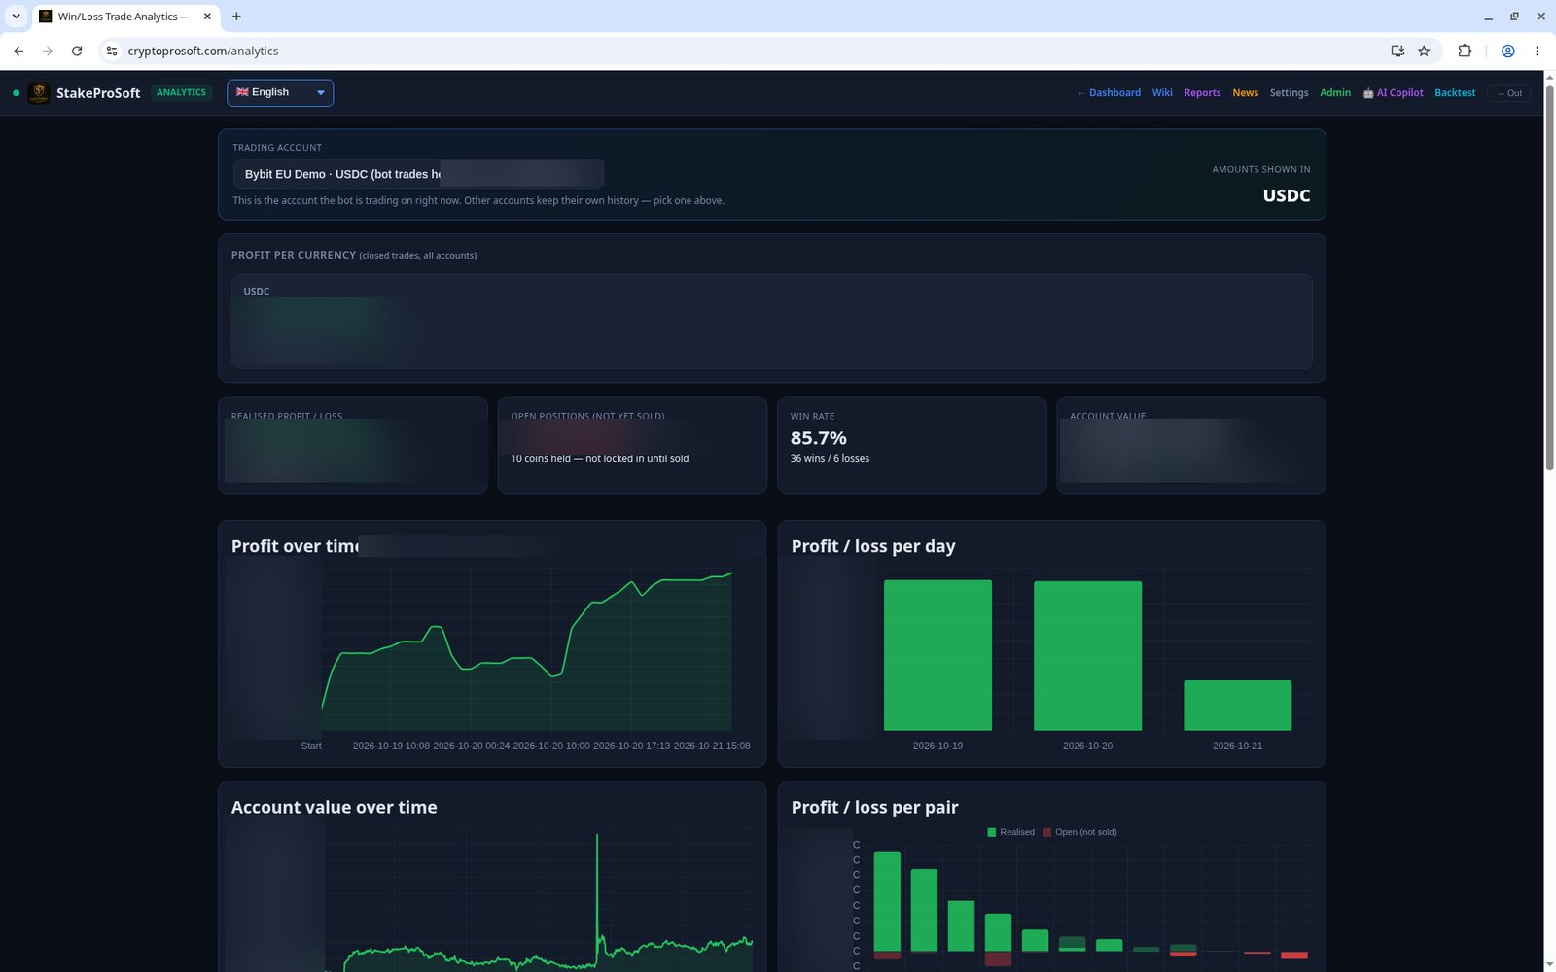
CryptoProSoft
Test first, then go live
Run a strategy on downloadable price history in the backtester. The optimizer finds settings you can save and apply as presets. Then trade in paper or demo mode before you go live.
3
modes: paper, demo and live
Analytics & charts (demo data) – values blurred
Notes:
Screenshot: analytics, demo data, money values blurred. Backtester with downloadable price history; optimizer with saveable/applyable presets; modes paper (default), demo/testnet, live. No profit claims on this slide. Sources: /workspace/crypto_screens/crypto-robot-summary.md, /workspace/crypto_page/facts.md

Slide 12
CryptoProSoft
The AI crypto trading bot is coming soon
2027
Be first in line for the 2027 model. Join the waitlist, and we will contact you as soon as it launches.
Join the waitlist
stakeprosoft.com/contact
Risk warning
Crypto trading is risky and your capital is at risk. Prices can move fast, and you may lose some or all of your money. CryptoProSoft is software, not financial advice. Past and demo results do not predict future performance. Only trade money you can afford to lose.
Notes:
Coming soon, 2027 model, waitlist at https://stakeprosoft.com/contact. Risk warning text from the product page. No profit or win-rate claims in this deck. Source: /workspace/crypto_page/crypto.html

