Slide 1
ValueBot AI
by StakeProSoft
ValueBot
AI
bet365 Value Bet Bot 2027
Coming soon · Join the waitlist for early access
Notes:
Title: bet365 Value Bet Bot 2027 - ValueBot AI by StakeProSoft. Coming soon; goal is to join the waitlist.
Source: /workspace/valuebot_page/valuebot.html (ValueBot product page, verified against source code).

Slide 2
ValueBot AI
Value betting: odds higher than the true chance
Example
2.20
2.00
bet365 odds
Fair odds (50% chance)
A value bet is a price that pays more than the outcome's real chance of winning is worth. Fair odds express that real chance. When bet365 offers higher odds than fair, the bet has positive expected value. Any single bet can still lose: the edge only shows over many bets.
bet365 pays above fair, so this is a value bet
Notes:
Value bet = bookmaker odds higher than fair odds (general value-betting concept). Example is illustrative: fair chance 50% = fair odds 2.00; bet365 2.20 is above fair.
No profit guarantee: losing days are normal; value betting is about long-term expected value.
Source: /workspace/valuebot_page/valuebot.html (ValueBot product page, verified against source code).

Slide 3
ValueBot AI
How fair odds work
01. Pinnacle reference price
Start from Pinnacle, the sharpest bookmaker, and remove its margin. Example: 1.95 / 1.95 implies 51.3% + 51.3%. Scaled to 50% each, fair odds are 2.00.
02. Remove the margin
03. Edge = odds ÷ fair − 1
bet365 at 2.20: edge +10%, EV +0.10 per unit staked
04. EV = prob. × odds − 1
Notes:
Fair odds: take the sharp Pinnacle price, remove the bookmaker margin (normalise implied probabilities to 100%).
Edge = bet365 odds / fair odds - 1 = 2.20 / 2.00 - 1 = 10%. EV = probability x odds - 1 = 0.5 x 2.20 - 1 = +0.10 per unit. Illustrative numbers, general value-betting maths.
ValueBot compares bet365 with margin-free Pinnacle fair odds and only bets when the edge passes your minimum. Source: /workspace/valuebot_page/valuebot.html (ValueBot product page, verified against source code).

Slide 4
ValueBot AI
The manual way is slow
01. Odds compared tab by tab
03. Stakes by gut feeling
Finding value means checking prices one by one, then doing the fair-odds maths in spreadsheets and calculators.
Without a staking rule it is easy to guess, chase losses or overbet.
02. The price is gone
04. Hours at the screen
Odds move fast. By the time you click, the value price has often disappeared.
Manual value betting takes hours every day, and proving your edge needs notes you rarely keep.

Slide 5
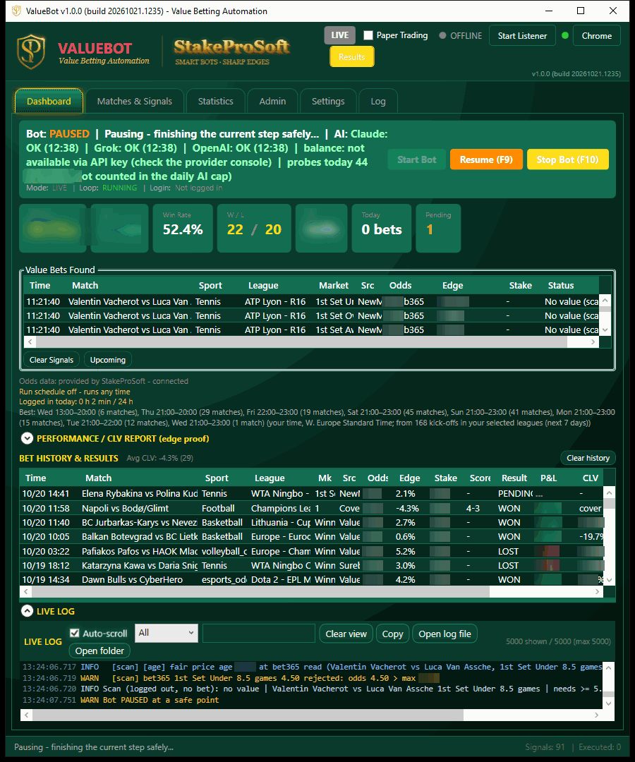
ValueBot AI
Meet ValueBot
Windows desktop app
ValueBot compares every bet365 price with margin-free Pinnacle fair odds across 15 sports, pre-match and live, and places singles within your limits.
Start in paper mode with zero risk, then switch to live when the numbers convince you.
Real ValueBot screenshot. Amounts hidden.

Slide 6
ValueBot AI
How ValueBot works in 4 steps
1
2
3
4
Scan while logged out
Find value vs fair odds
Log in, check, bet
Log out, settle, report
Pulls odds from 5 odds feeds and reads bet365 while logged out.
Pinnacle prices become fair odds. bet365 prices above fair by your minimum edge become candidates.
Logs in only to bet, re-checks the edge on the live on-screen price and sets a flat or fractional Kelly stake.
Logs out, settles bets automatically, tracks CLV and adds every result to the ledger and PDF reports.

Slide 7
ValueBot AI
5 odds feeds, 15 sports
Every bet365 price is compared with Pinnacle fair prices, pre-match and live singles, with a final edge check on bet365's live on-screen price.
01. Odds feeds, auto source
02. 15 sports, pre-match + live
oddssea (default), The Odds API, StakeProSoft Odds Server, OddsPapi and pinnodds. Auto source picks a working feed; cross-checks block stale or mismatched prices.
Football, Tennis, Basketball, Baseball, Ice Hockey, American Football, Volleyball, Esports, Darts, MMA, Boxing, Snooker, Cricket, Handball and Rugby.

Slide 8
ValueBot AI
01. Reads the screen
When normal OCR (text reading) fails, Claude, Grok or OpenAI read the bet365 screen instead.
AI inside
Claude, Grok and OpenAI on call
02. AI tips and health checks
AI tips on upcoming fixtures, plus an hourly credit and status check for each AI provider.
AI is optional and runs on your own API keys. The bot learns from every AI answer, so it needs fewer calls over time.
03. Keeps costs down
Learns from AI answers to need fewer calls, and falls back to a cheaper model.

Slide 9
ValueBot AI
Safety guards built in
A daily bet cap, a daily loss limit and a low-balance guard that stops betting when funds run low.
ValueBot stays off casino pages, never touches deposit, limit or Spelpaus popups, and logs out automatically within Sweden's 24h limits.
18+ only. Bet responsibly.
Gambling involves risk and no betting software can guarantee winnings. Only bet what you can afford to lose.
Need help? Visit Stödlinjen (stodlinjen.se) or BeGambleAware.org. ValueBot is independent software, not made by or affiliated with bet365 or Pinnacle.

Slide 10
ValueBot AI
Settings and presets that match your risk
01. Presets and stakes
02. Paper first, then live
Conservative, Standard and Aggressive presets. Flat stake or fractional Kelly with a hard cap. Export and import settings (no keys or passwords).
Paper mode finds and logs bets with zero risk. Switch to live when the numbers convince you. Every bet settles automatically.

Slide 11
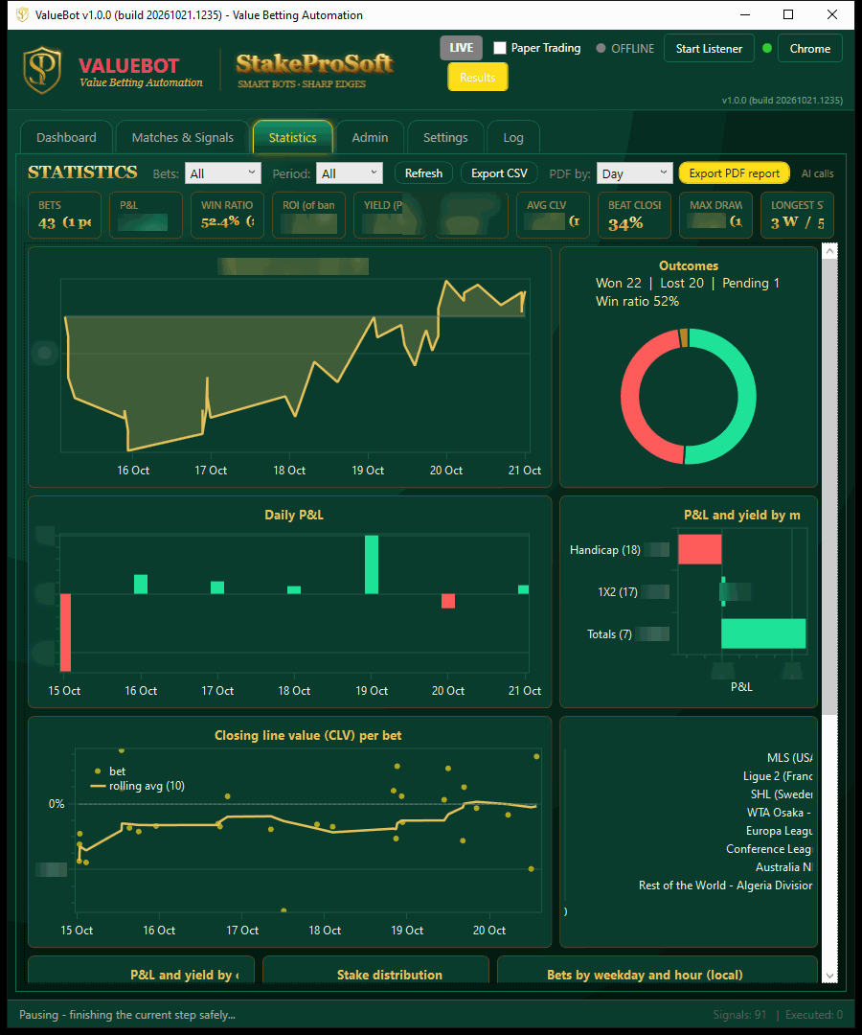
ValueBot AI
Track every bet, prove your edge
Bankroll curve, outcomes, daily P&L, P&L by market and CLV per bet with a rolling average. Break results down by sport, source and market.
Export CSV and PDF reports, keep daily backups, and check the bot on the Windows and Android monitor app.
CLV
tracked on every bet
Real ValueBot screenshot. Amounts hidden.

Slide 12
ValueBot AI
ValueBot is coming soon
2027
Be first in line. Waitlist members get early access and launch pricing for ValueBot AI before public release.
No spam. One email when ValueBot launches. 18+ only.
Join the waitlist
stakeprosoft.com

